Slide 1
Generative AI & Prompt Engineering - An Introduction

Slide 2
In this video, we will discuss:
Introduction to Generative AI
LLMs: A Deep Dive
Using LLMs with Anyscale APIs
Prompt Engineering Fundamentals
Using LLMs for classification and summarization
Agenda
Introduction to Generative AI and Prompt Engineering

Slide 3
Design and implement computer programs that can reason, learn and act in complex environments.
Artificial Intelligence
Superset of
Design of algorithms that enable computer systems to learn from data efficiently.
Machine Learning
A subset of ML that uses neural network algorithms for predictive applications.
Deep Learning
Algorithms that generate original content, such as images, text, voice, or music, by learning patterns from a dataset.
Generative AI

Slide 4
Large Language Models (LLMs)
Large Multimodal Models (LMMs)
LLMs are trained using language modelling, which involves predicting the next word in a sentence. They have excellent reasoning capabilities and can be used for several natural language tasks (e.g., summarisation).
Trained using a mixture of images, video and text. LMMs demonstrate a nuanced understanding of multimodal inputs and can be used for several mixed-input tasks (e.g., video summarization)
Generative AI

Slide 5
Large Language Models (LLMs)
LLMs are trained using language modeling, that is, predicting the next word in a sequence. They do so by assigning probabilities to a fixed vocabulary.
Vocabulary
positive | p = .03
negative | p = .00001
…
magical | p = .83
The movie is a visually stunning, action-packed, and emotionally resonant thrill ride that will leave you on the edge of your seat from beginning to end. Overall, the experience was magical.

Slide 6
Large Language Models (LLMs)
LLMs are trained using language modeling, that is, predicting the next word in a sequence. They do so by assigning probabilities to a fixed vocabulary.
Vocabulary
positive | p = .03
negative | p = .00001
…
magical | p = .83
The movie is a visually stunning, action-packed, and emotionally resonant thrill ride that will leave you on the edge of your seat from beginning to end. Overall, the experience was magical.
match

Slide 7
Large Language Models (LLMs)
During inference, the LLM predicts the next word in the input sequence.
Input word = prompt
The
Output, word-by-word awesome. Overall, the experience was positive.
positive
The
The movie
negative
...
The movie was
movie
The movie was awesome.
The movie was awesome. Overall,
magical
The movie was awesome. Overall, the
Vocabulary
⁞

Slide 8
Large Language Models (LLMs)
New Era of AI started in Nov 2022 with the Launch of Open AI GPT 3.5 since then AI has been evolving to be AI assistants
2018
GPT (117M parameters): The first model is to be trained in a “generative” mode by masking portions of input text from left to right
2019
GPT-2 (1.5B parameters): The era of prompting begins. Models are relatively small, open-source and fine-tuning is possible
2020
GPT-3 (175B parameters): Large-scale foundation models are born. Prompting is shown to induce robust performance on natural language tasks
2022
InstructGPT: Instruction-tuned models understand human inputs as instructions; the path to ChatGPT is paved
2023
GPT-4 (1T parameters?): Era of completely closed models begins; API access only
2024
GPT-4O (SORA, GEMINI Pro 1.5): (SORA, The era of multi-modal and highly specialised AI models. Enhanced integration with various data types (text, image, video, audio) and fine-tuned for specific applications and industries.

Slide 9
Large Language Models (LLMs)
The Evolution of AI Assistants: From GPT-1 to GPT-4o
GPT-1 (117M parameters): This model marks a significant milestone as the first to be trained in a 'generative' mode, a technique that involves masking portions of input text from left to right. This approach sets the foundation for the evolution of subsequent models.
GPT-2 (1.5B parameters): Th is model marks a transition to 'prompting,' a technique that allows for more interactive and specific responses. With relatively small and open-source models, fine-tuning becomes possible, opening up new possibilities in the field.
GPT-3 (175B parameters): Large-scale foundation models are born. Prompting is shown to induce robust performance on natural language tasks.
InstructGPT: Instruction-tuned models understand human inputs as instructions; the path to ChatGPT is paved.
GPT-4 (1T parameters?): Era of completely closed models begins; API access only.
GPT-4O (SORA, GEMINI Pro 1.5): The era of multi-modal and highly specialised AI models. Enhanced integration with various data types (text, image, video, audio) and fine-tuned for specific applications and industries.

Slide 10






Accessing Large Language Models (LLMs)
LLMs (both paid and open source) can be accessed either through public cloud providers, LLM vendors or using self-hosted company servers.
Google: Gemini
Open AI: GPT-3.5, GPT-4
Anthropic: Claude
Cohere: Command
Paid
LLMs
Open Source
Meta AI: Llama
Mistral AI: Mistral, Mixtral

Slide 11
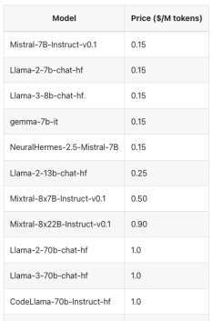

Accessing LLMs using Anyscale APIs
Anyscale provides fast access to a host of open-source large language models.
In this tutorial, I used Mistral 7B Instruct and NeuralHermes 2.5. These models are priced at $0.15 per 1 million tokens. Both models have excellent reasoning capabilities and are popular enterprise-grade LLMs.

Slide 12
Accessing LLMs using Anyscale APIs
A token refers to a segment or piece of data, such as a word, punctuation, or other meaningful element, into which input text is divided for processing by the model.
The movie was awesome. Overall, the experience was positive.
Clear
Show example
LLM
Parses sentences as tokens
Tokens
Characters
12
60
The movie was awesome. Overall, the experience was positive.

Slide 13
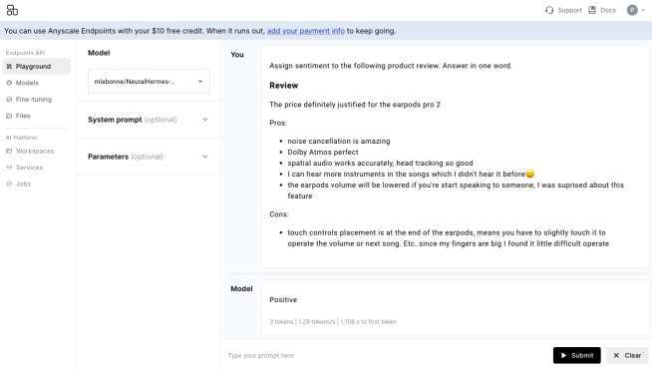
Accessing LLMs using Anyscale APIs
The Anyscale Playground enables iterative development for prompt engineering, that is, designing specific instructions for LLMs to accomplish a task.

Slide 14
Accessing LLMs using Anyscale APIs
The Anyscale Playground enables iterative development for prompt engineering, that is, designing specific instructions for LLMs to accomplish a task.
Anyscale
API
Prompt format
API Key
Playground enables quick iterations on prompts. Once an effective prompt is discovered, it is translated to code for efficient API access
Anyscale API’s are compatible with Open AI. This allows seamless switch over between Anyscale and Open AI if needed.

Slide 15
Applications of Generative AI
Anyscale APIs are compatible with Open AI APIs and have the following three components.
System Message Clear instructions explaining the task that the LLM should accomplish. These instructions are agnostic to the user input and appended to the user input with higher priority. Can also be used to prime LLM behaviour
User Message Specific instructions from the user describing the task that needs to be accomplished.
Assistant Message Not needed for single-turn conversations. Can be used to showcase expected completions in multi-turn conversations.
LLM API
Prediction

Slide 16
Applications of Generative AI
Python
JavaScript Go
Gen AI Developers
Classification
Generating Labels Category Assignment
are
using
Impactful problems
to solve
Summarization
Generating Code Retrieval-Augmented Q&A
Text to Text
LLM APIs
Anyscale

Slide 17
Prompt Engineering Fundamentals
Prompt = Specific set of instructions sent to a LLM to accomplish a task
Engineering = Iteratively deriving a specific prompt for the task
Max output length
Length of output
Prompt
More temperature = More
randomness in response
Temperature
Parameters
Structure
More Top P = More tokens selected for completion
Top P
More FP = Less chance of tokens repeating
Frequency Penalty (FP)

Slide 18
Prompt Engineering Fundamentals
Understanding temperature
Temperature = 0
The overall experience was
The overall experience was positive
Repeated execution produces the same results
The overall experience was positive
The overall experience was positive
LLM
Temperature = 1
The overall experience was positive
Repeated execution can produce different results
The overall experience was magical
positive
negative
magical
The overall experience was negative
0.6
0.1
0.3

Slide 19
Prompt Engineering Fundamentals
Components of a prompt template
System Message Clear instructions explaining the task that the LLM should accomplish. Should include the expected format of user input and output and a chain of thought to accomplish the task.
Few Shot Examples Input - Output pairs delineating the expected response for exemplar inputs.
User Input Input presented in the format mentioned in the system message
LLM API
Prediction

Slide 20
Prompt Engineering Fundamentals
Zero-shot prompt template example - sentiment analysis
System Message Classify customer reviews in the input as positive or negative in sentiment. Reviews will be delimited by triple backticks, that is, ```. Do not explain your answer. Your answer should only contain the label: positive or negative.
User Input ```I couldn't be happier with my experience at your store!```
LLM API
Prediction

Slide 21
Prompt Engineering Fundamentals
Few-shot prompt template example - Summarization
System Message Summarize the dialogue mentioned in the user input. Be specific and concise in your summary.
Few Shot Examples User: ###Dialogue: #Person1#: Good afternoon Miss, would you be interested in buying more life insurance? You know, you can never get enough.\n#Person2#: I think my husband has some.\n#Person1#: Are you sure he ' s purchased enough insurance for both of you? Assistant: Person1# recommends #Person2# to buy more life insurance. Even though #Person2#'s husband has some, those insurances can't cover both of them.
User Input ###Dialogue: Person1#: Here we come. #Person2#: Thank you. What's the fare? #Person1#: $ 10. #Person2#: How can it be? ```
LLM API
Prediction

Slide 22
Prompt Evaluation
Prompt
Classification tasks
Summarization tasks
Predicted Labels
Predicted Summaries
Compared with
Rated according to
Ground Truth Labels
Evaluation Rubric

Slide 23
Summary
Foundation Models
Trained on language modeling
Train
Templates
System Message, Few Shot Examples
LLMs
Infer
Prompts
Parameters
Max Length, Temperature

